Slide 1
Fixing Household Questionnaire Result Code Status
Data Transfer: Interviewer (sender) >> Bluetooth >> Supervisor (receiver) >> IFSS >> Central Office

Slide 2
“I can’t access a HH/women interview!!!!”
Issues with Household result codes
This problem occurs when the supervisor sends an interviewer a new HH assignment before receiving data already collected from that interviewer
Result: when the new assignment is sent to interviewer, the existing result status for interviews begun by that interviewer may be overwritten and set to “Not Visited”
Suddenly, when using interviewer menu to access household, interviews that were completed or are ongoing look as though they were not visited

Slide 3
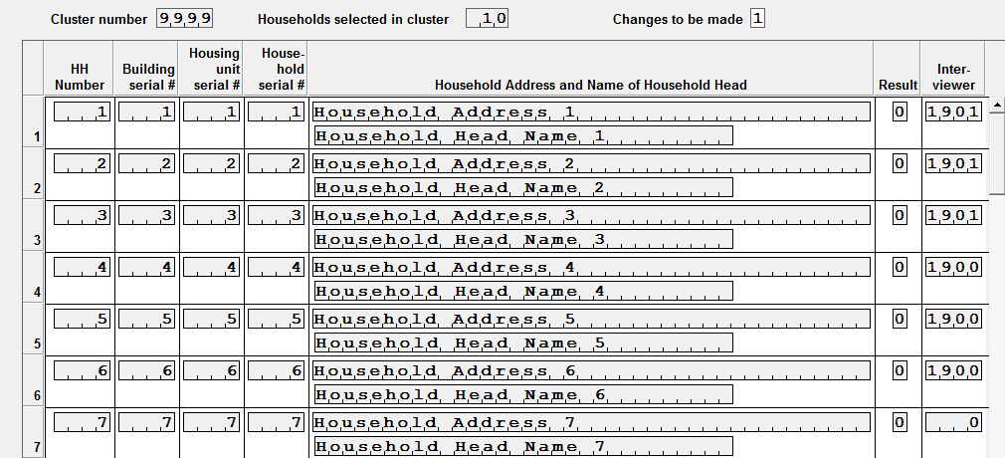
Initial sample setting - assignment
Not visited yet
Notes:
Go back to previous slide and go over each point of day 1 agenda

Slide 4

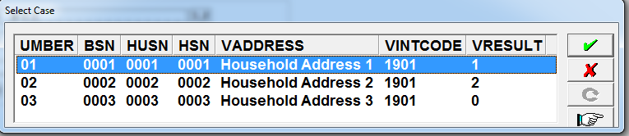
Interviewer computer: accessing a HH
Interviewer menu >> option 1,2 or 3 >> Assigned to me
When transfer data to supervisor
Assignment sheet is updated
2= Incomplete
1= Completed
0= Not visited or partial saved

Slide 5
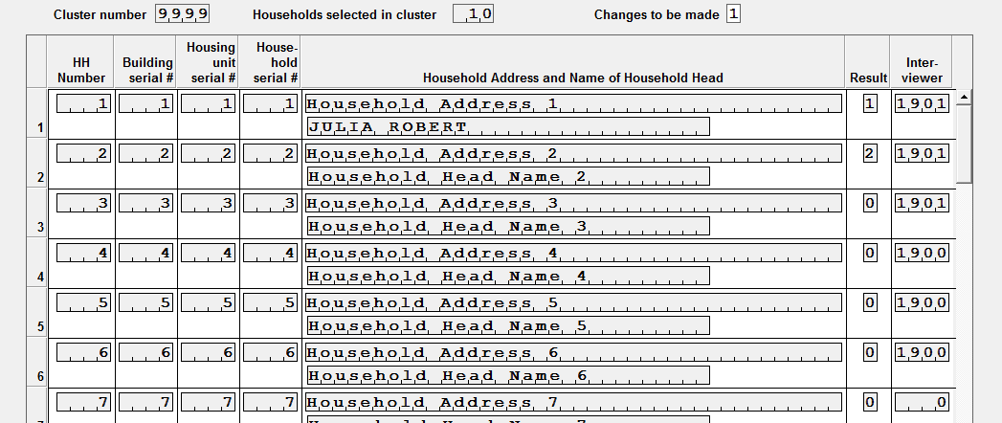
Updating the assignment data file
Transferring data update Assignment data file: Name of Head HH, Result….

Slide 6
Lesson Learned
Always transfer data from interviewer to supervisor before doing a new assignment transfer !

Slide 7
Adjusting household status after using data repair tool
Data Repair Action | Adjust household status
Household questionnaire deleted | Reset household code to “Not visited”
Household number changed | Correct status code for new household number to match correct status for that household

Slide 8
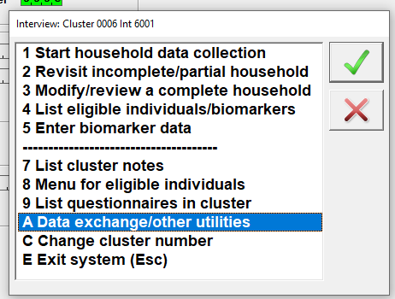
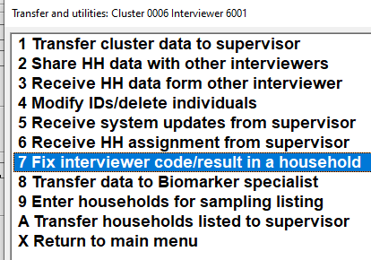
How to fix the problem
Interviewer menu
>> option A – Data exchange/other utilities
>> Option 7: Fix interviewer code/ result in a HH

Slide 9
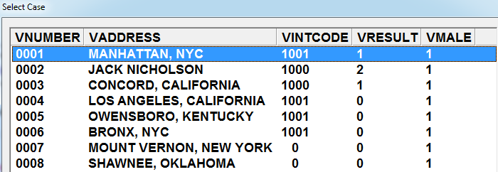
Select the household that to be fixed
Be very careful while selecting the household. Should be right!!!!!

Slide 10
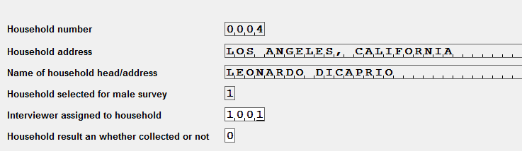
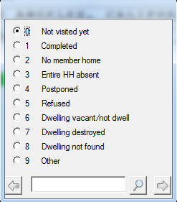
Select the household that need to be fixed
Before making any changes, verify HH number, Name and address
Click on household result field and select result
This tool can be used to repair the interviewer code

Slide 11
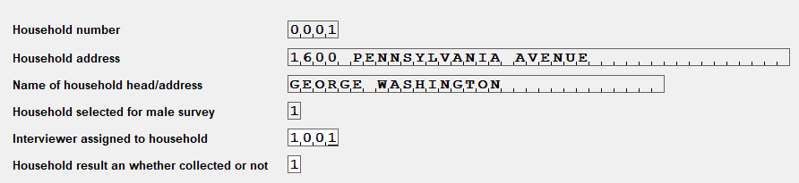
Practice
II. Interviewer code on assignment
Use the same procedure to fix interviewer
Interviewer menu
>> Option A – Data exchange/other utilities
>> Option 7: Fix interviewer code/ result in a HH
>> Select the household whose assignment needs to change
Before making any changes, verify HH number, Name and address
>>Click on interviewer code and enter the correct one (or yours)

Slide 12
Practice
Practice with HH result code fixing
Practice with interviewer code fixing
Notes:
Practice on your laptop and bring back the original codes
Ask participants to practice and to bring back original codes

